Slide 1
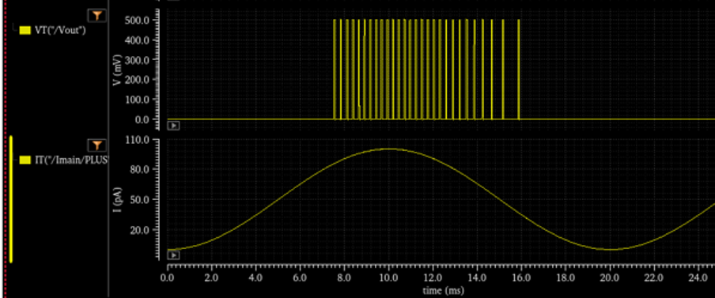
Output spikes:
Frequency of
Spikes increase with
Iin
Input Current:
Sinus wave
Freq=50Hz
Amp 0-100pA

